Slide 1
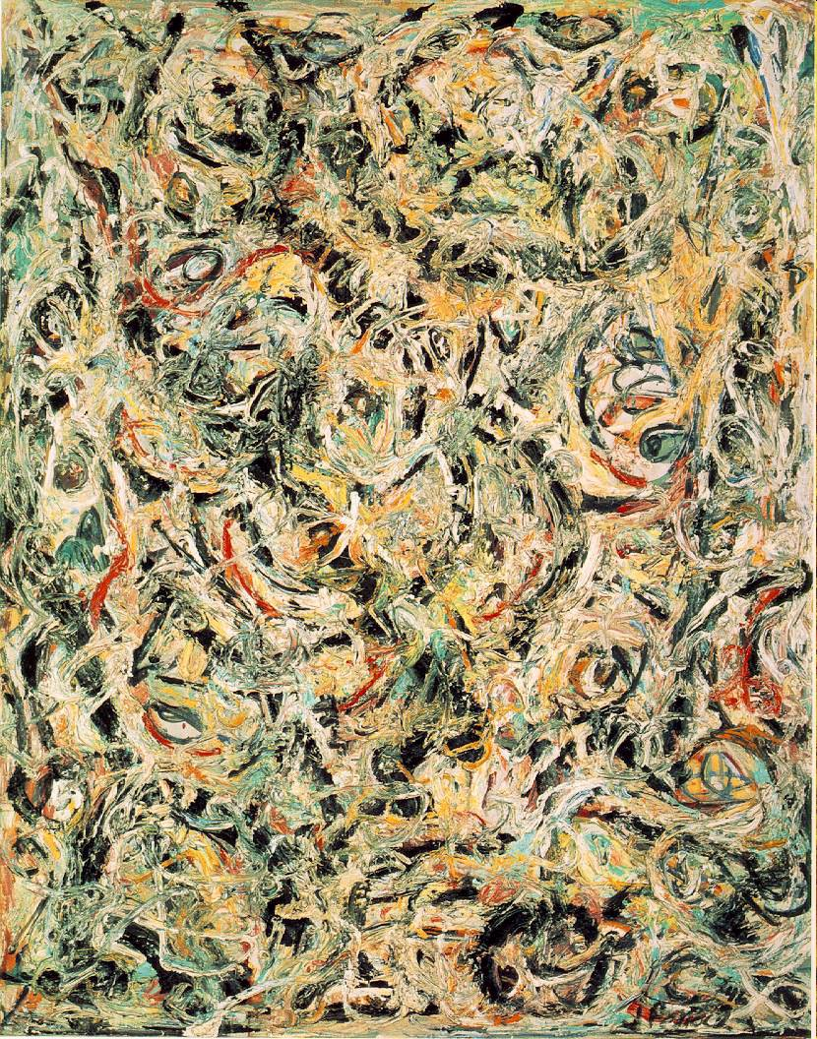
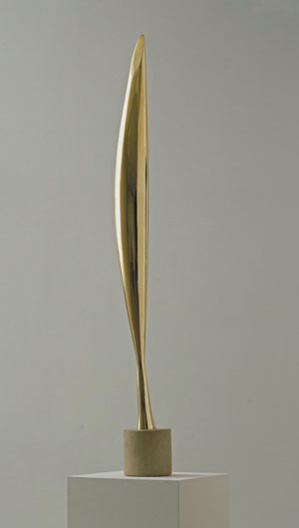
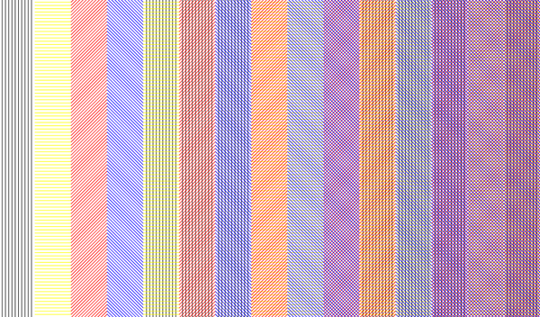
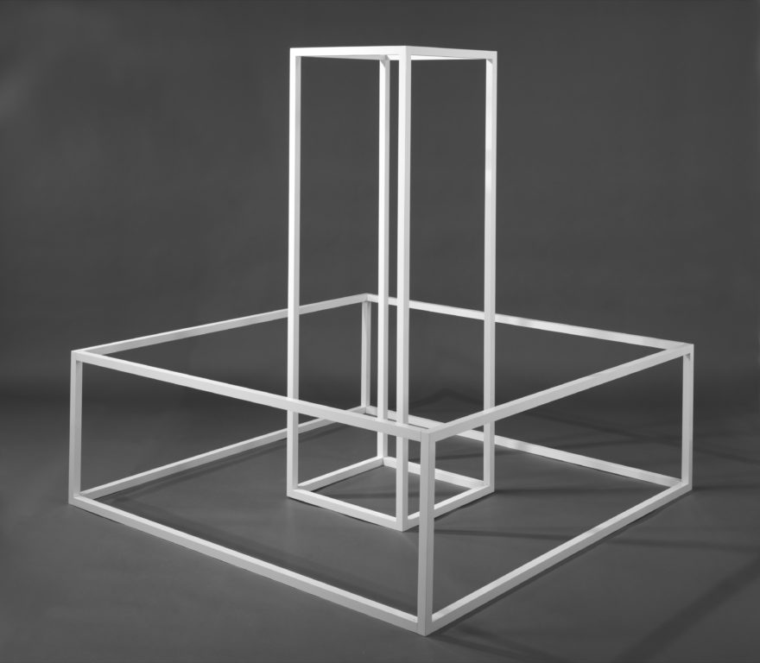
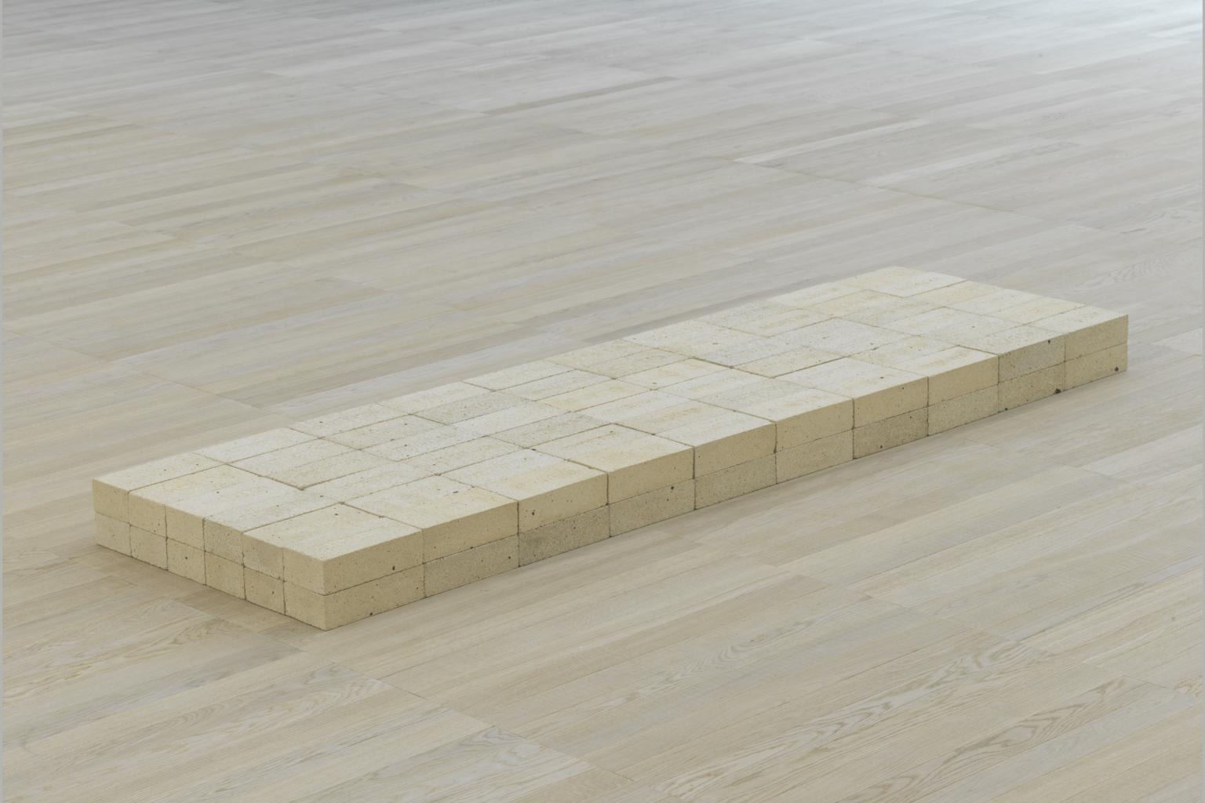
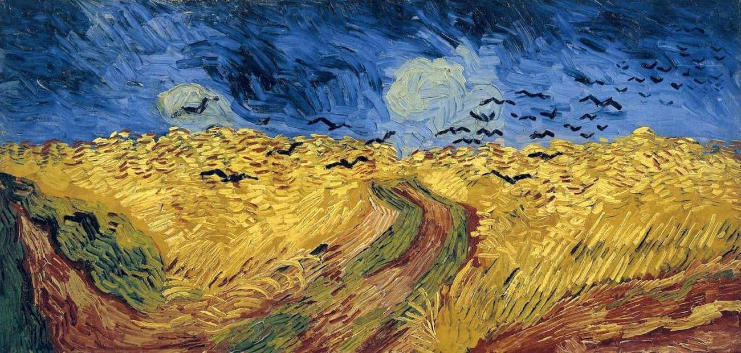
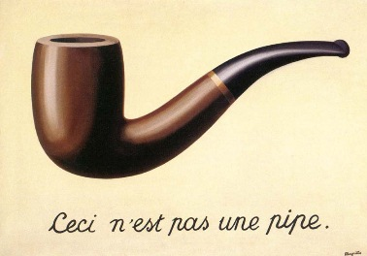
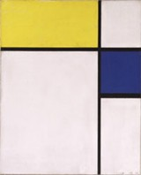
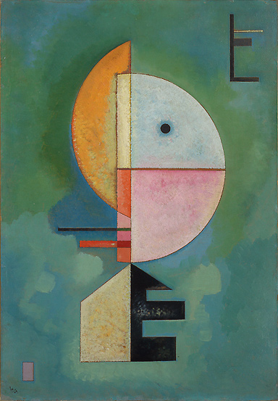
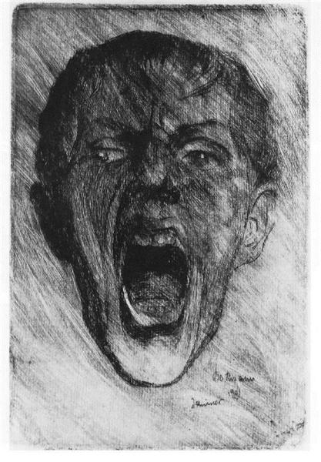
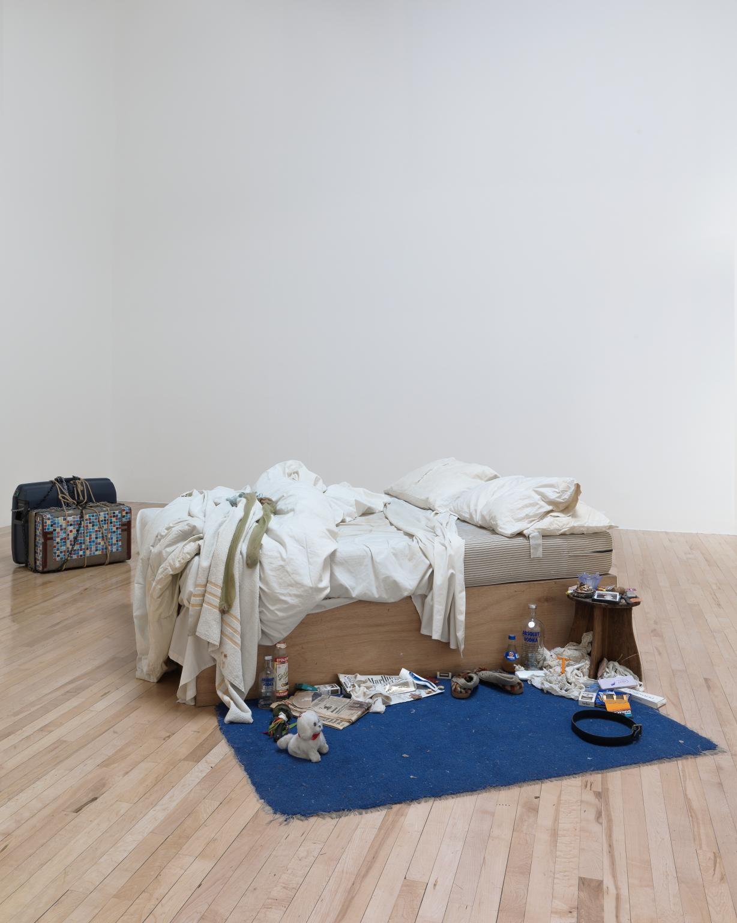
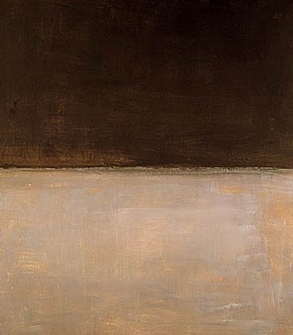
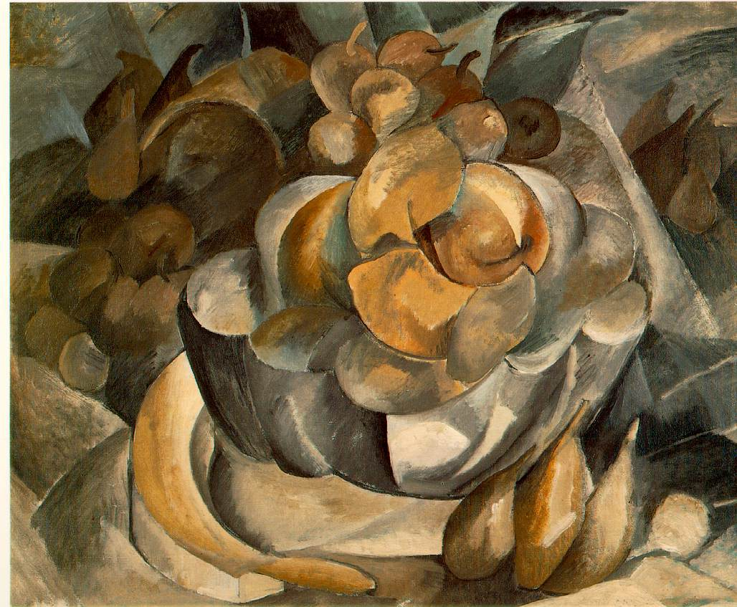
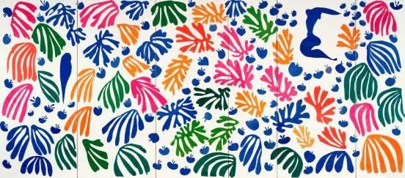
…ISMS. AN INTRODUCTION TO MODERN ART
www.andrew-james-taylor.com
andrewtaylor753@gmail.com

Slide 2
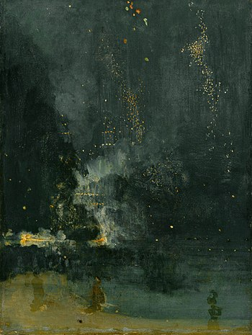
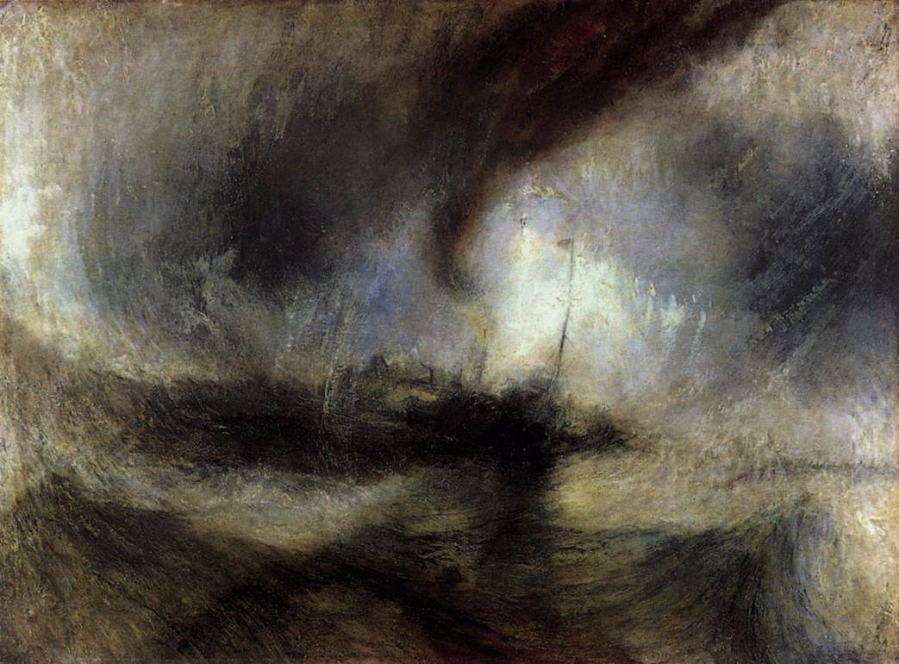
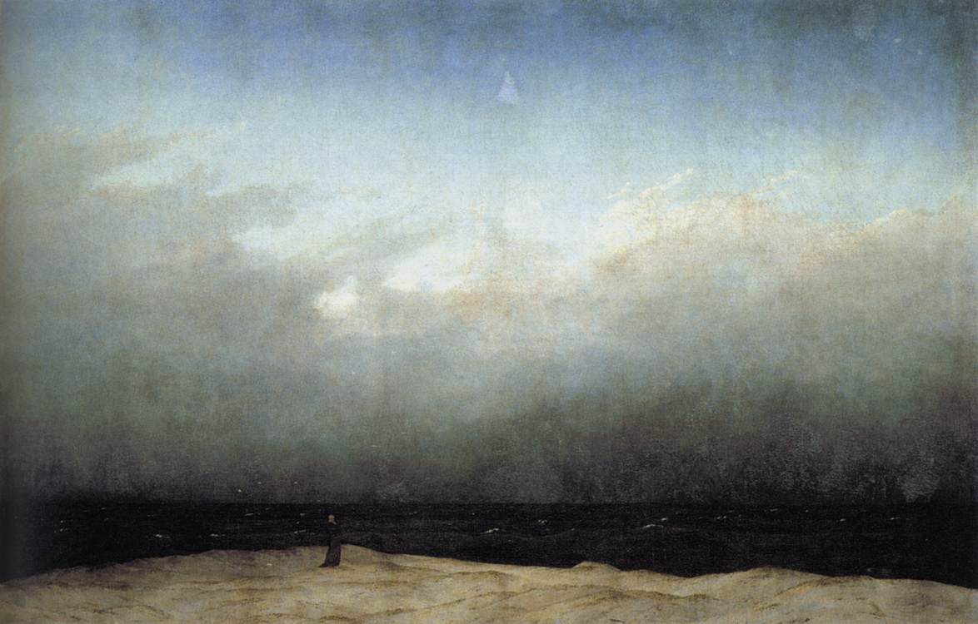

Slide 3
James Whistler.
Nocturne in Black and Gold. The Falling Rocket. 1875
J.M.W. Turner.
Snow Storm: Steam-Boat off a
Harbour's Mouth. 1842.
Caspar David Friedrich.
Monk by the Sea. c1810.

Slide 4
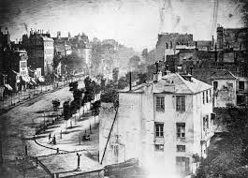
Louis Daguerre. Boulevard du Temple. 1838

Slide 5
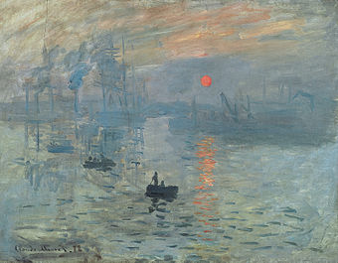
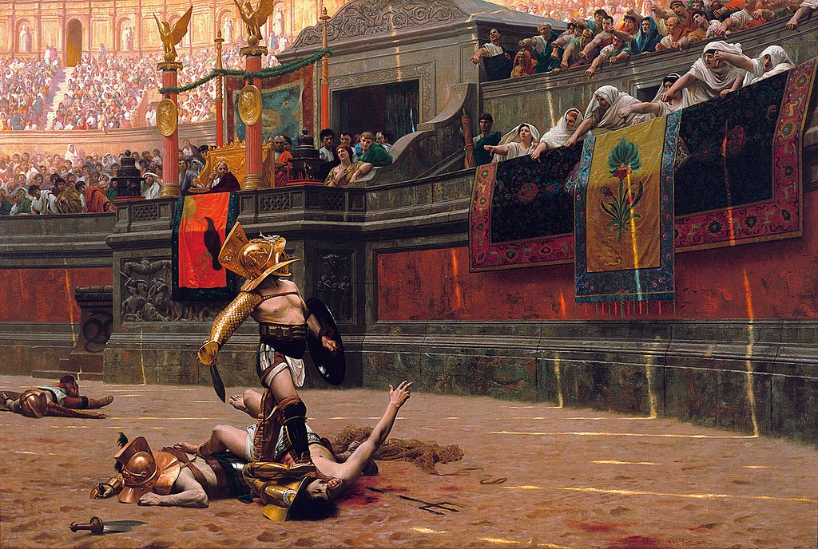
France. 1872.
Claude Monet. Impression Sunrise
Jean-Leon Gerome. Pollice Verso

Slide 6
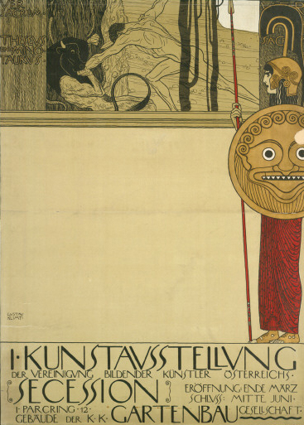
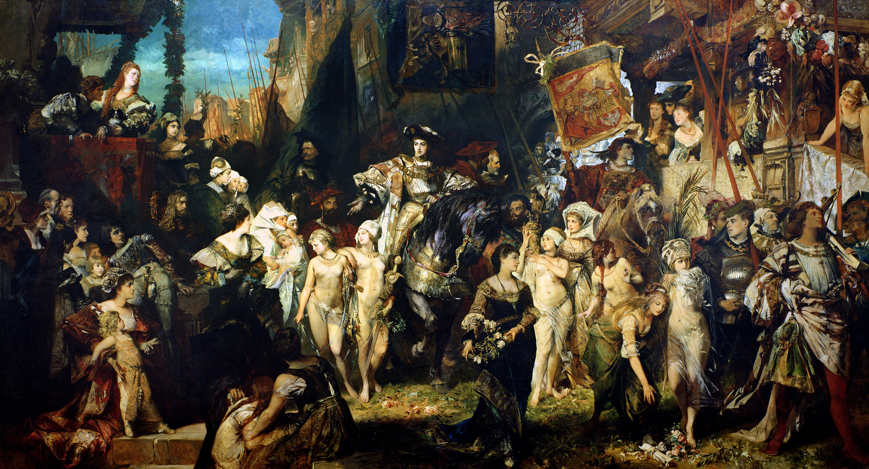
Vienna. The beginnings of the modern.
Hans Makart. The Entry of Charles V into Antwerp. 1878
Gustav Klimt. Poster for Vienna Secession. 1898

Slide 7
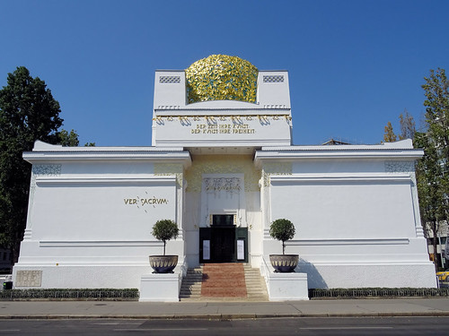
Vienna Secession Building.
1897

Slide 8
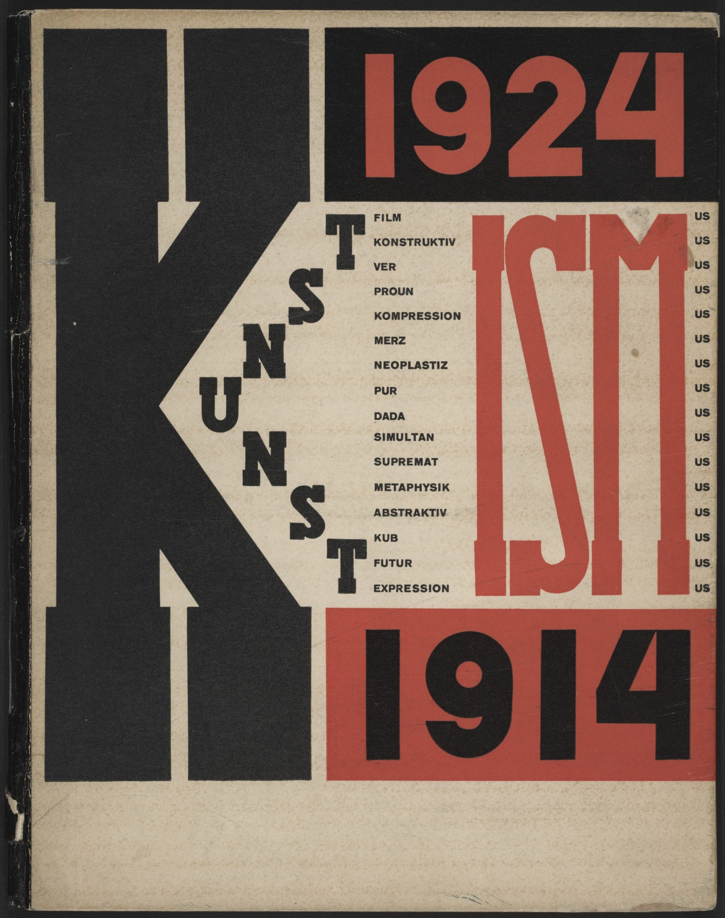

Slide 9
Claude Monet. Impression Sunrise
1872
impressionism
A preliminary drawing for a wallpaper pattern is more finished than this seascape.
Louis Leroy. The Exhibition of the Impressionists.

Slide 10
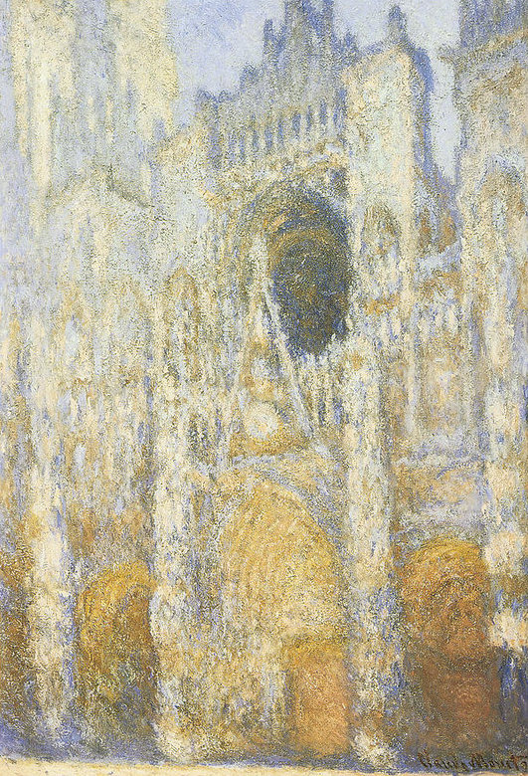
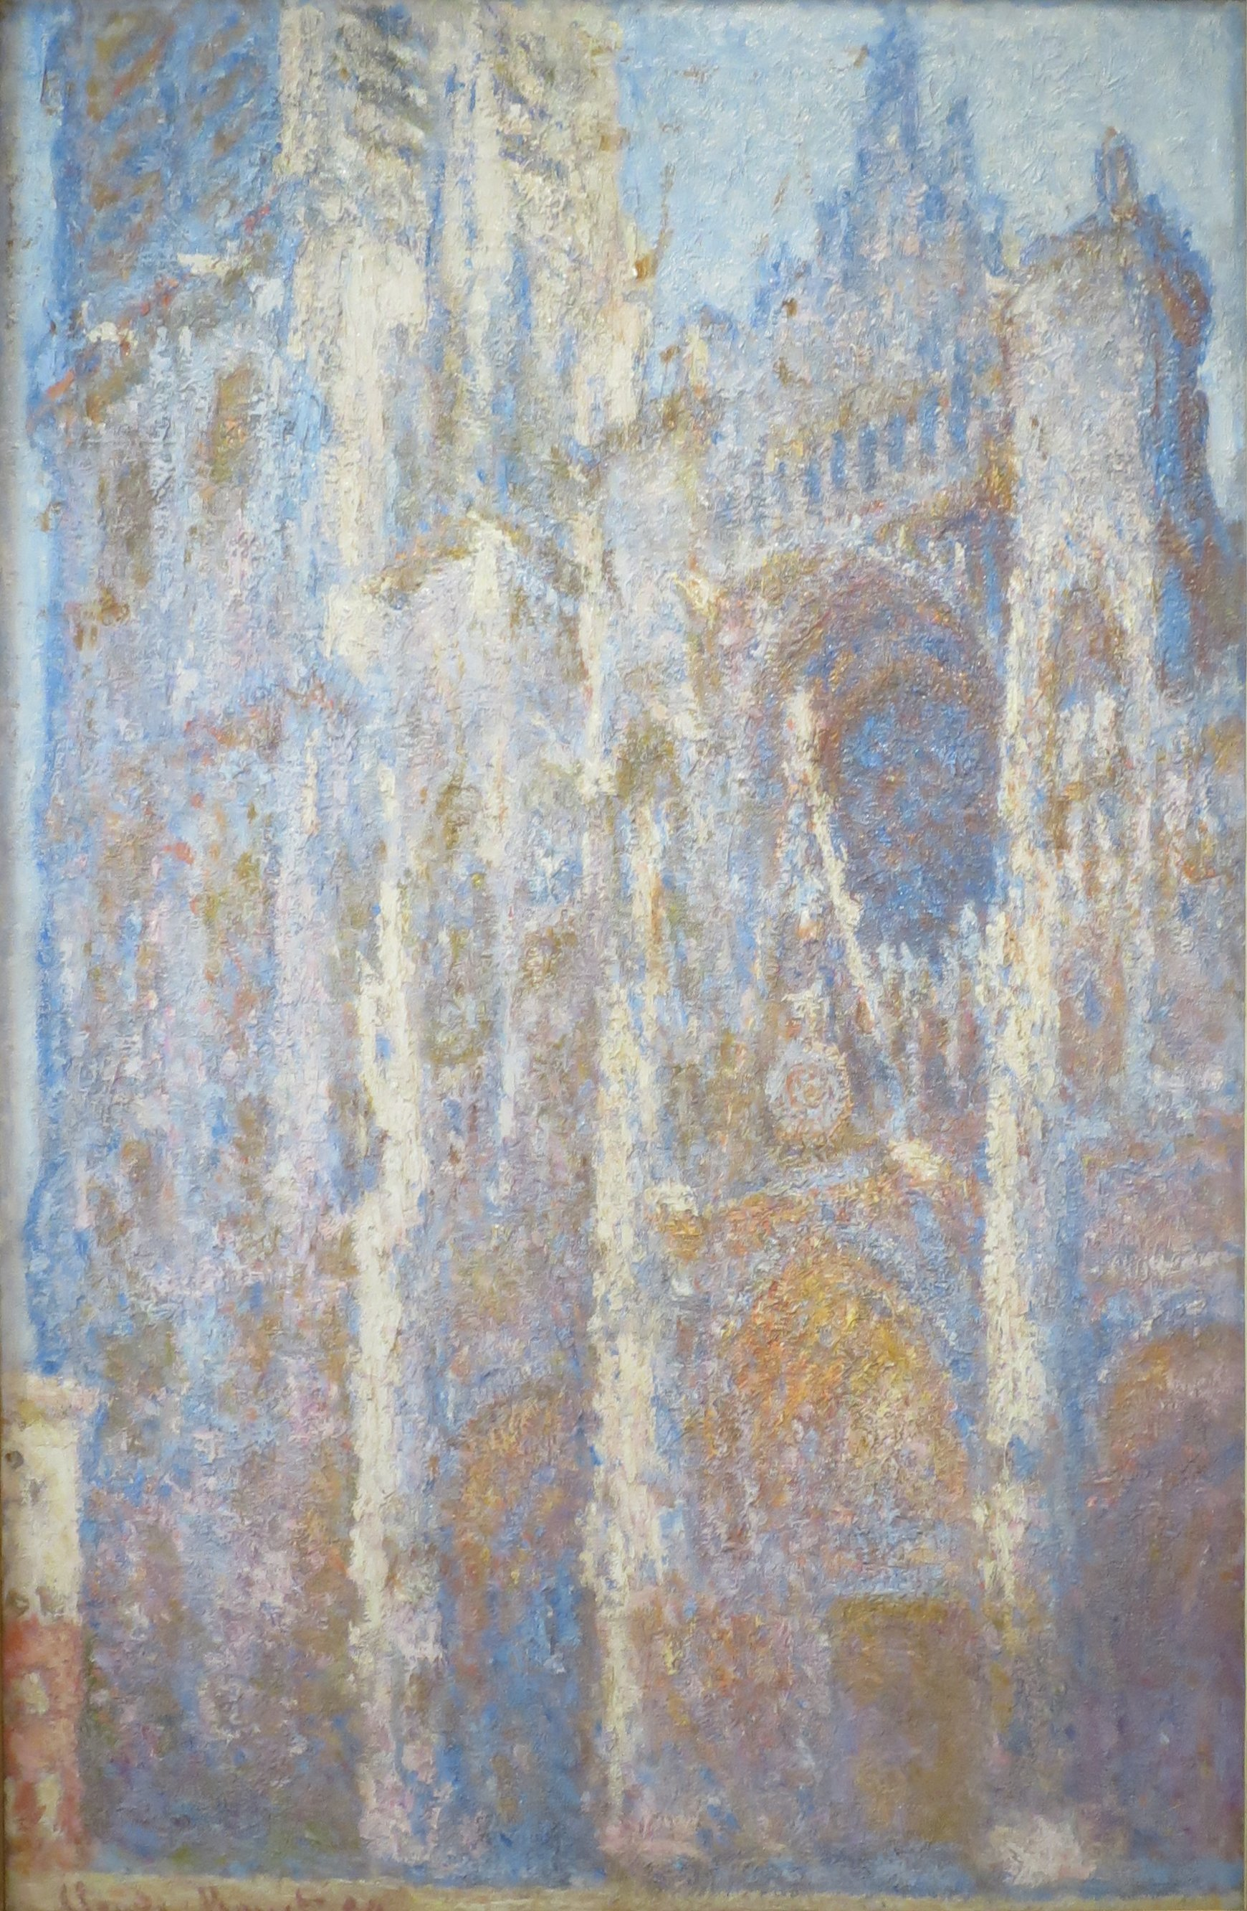
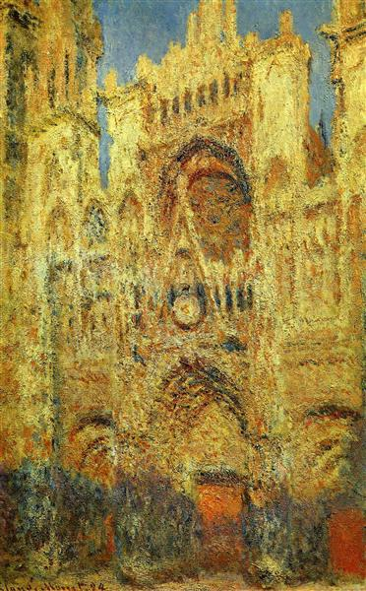

Slide 11
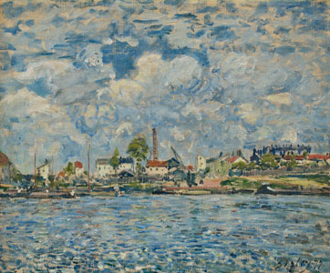
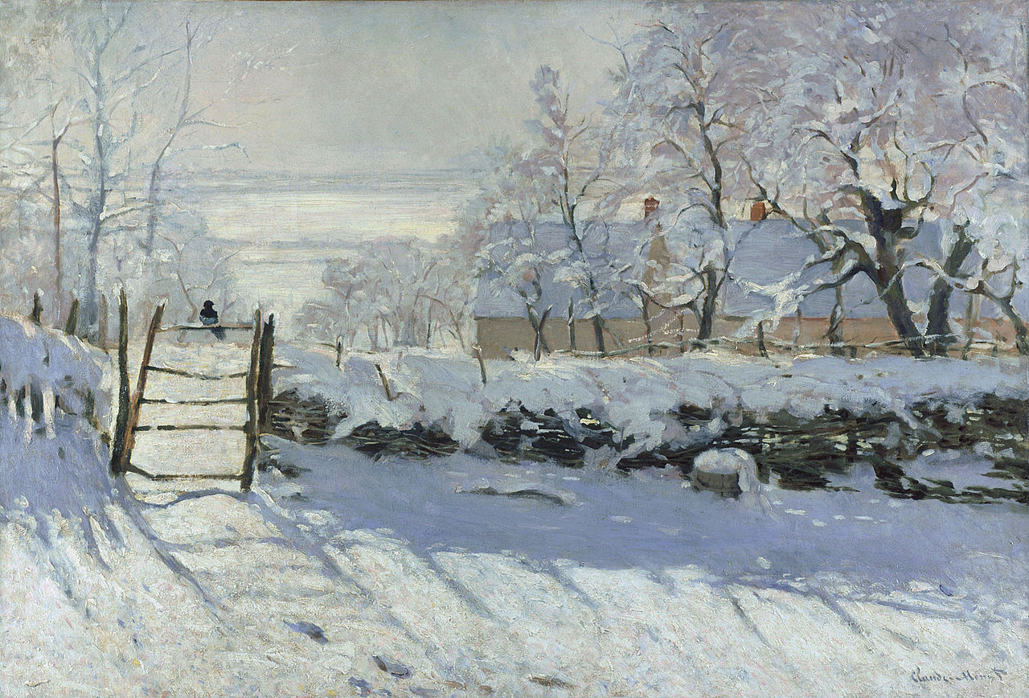
Water and Shadow
Alfred Sisley. La Seine au point du jour. 1877
Claude Monet. The Magpie. 1868-69.

Slide 12
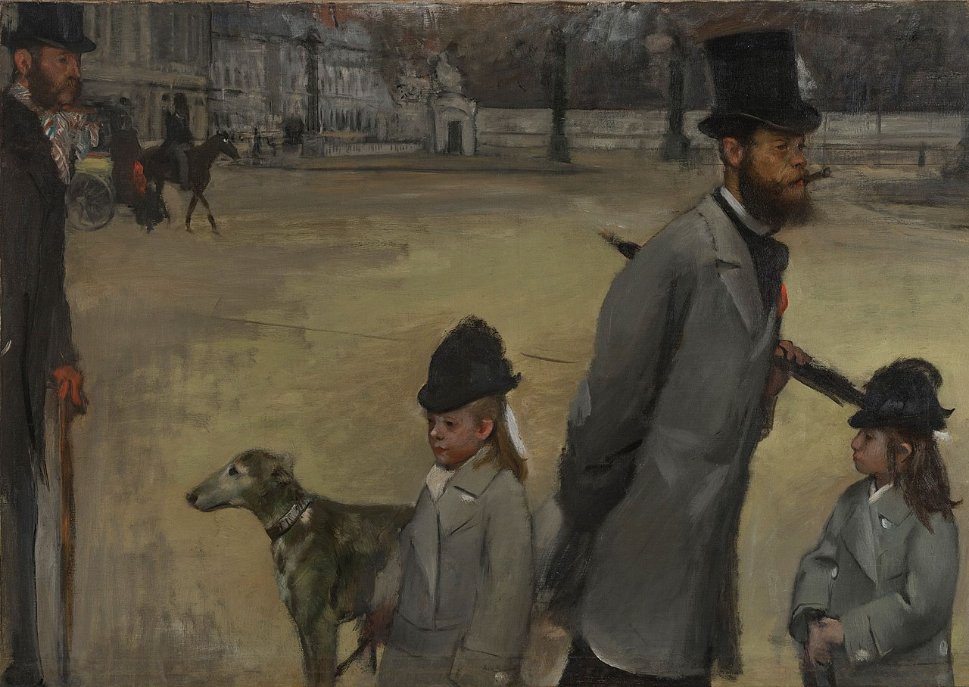
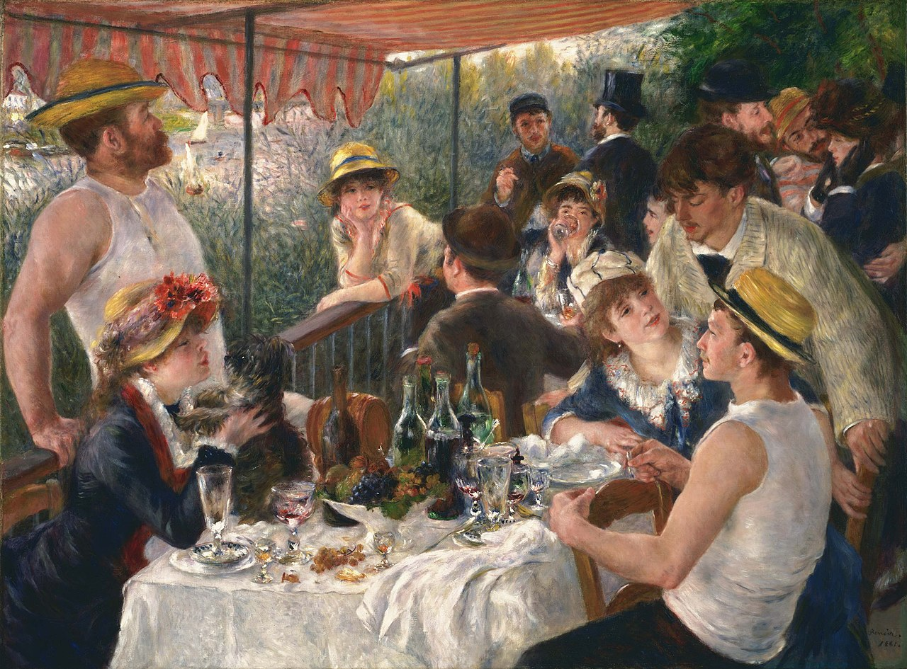
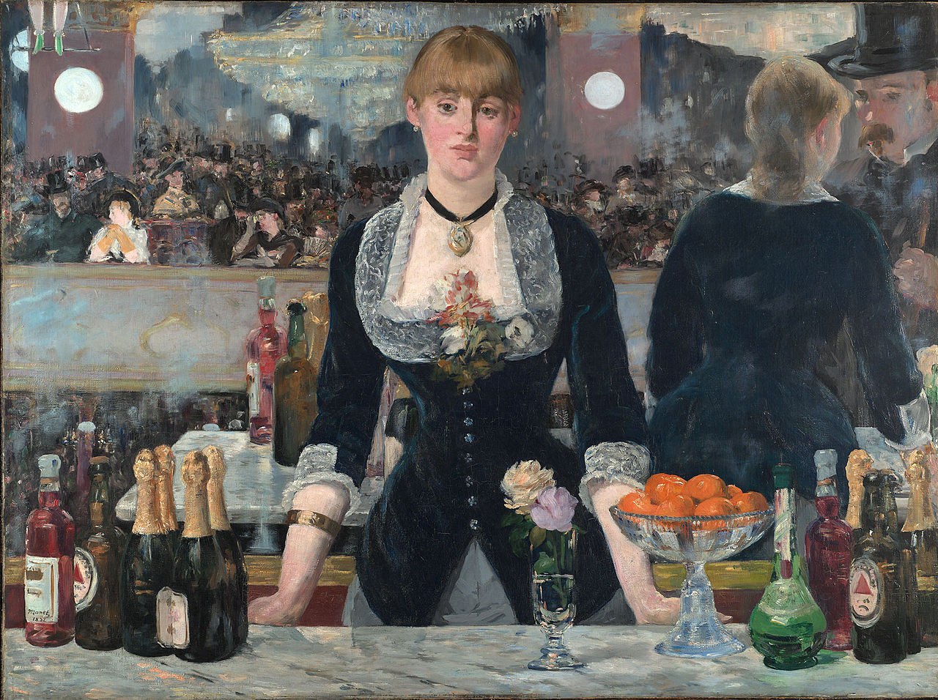
Edgar Degas.
Place de la Concorde. 1875
Pierre-Auguste Renoir
Luncheon of the Boating Party
1880-81
Edouard Manet,
A Bar at the Folies-Bergère. 1881-2

Slide 13
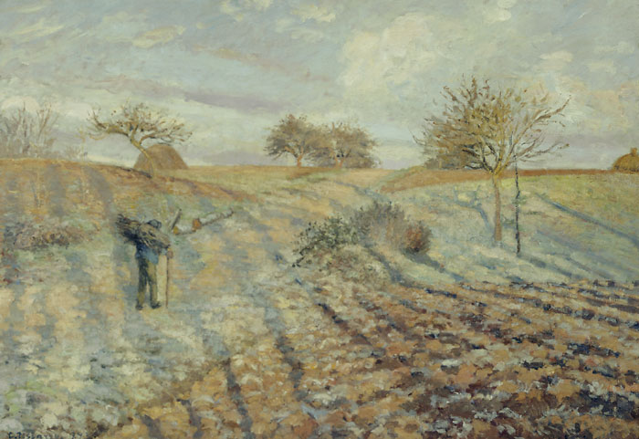
Camille Pissarro.
Gelée Blanche (Ploughed Field).
1874.

Slide 14
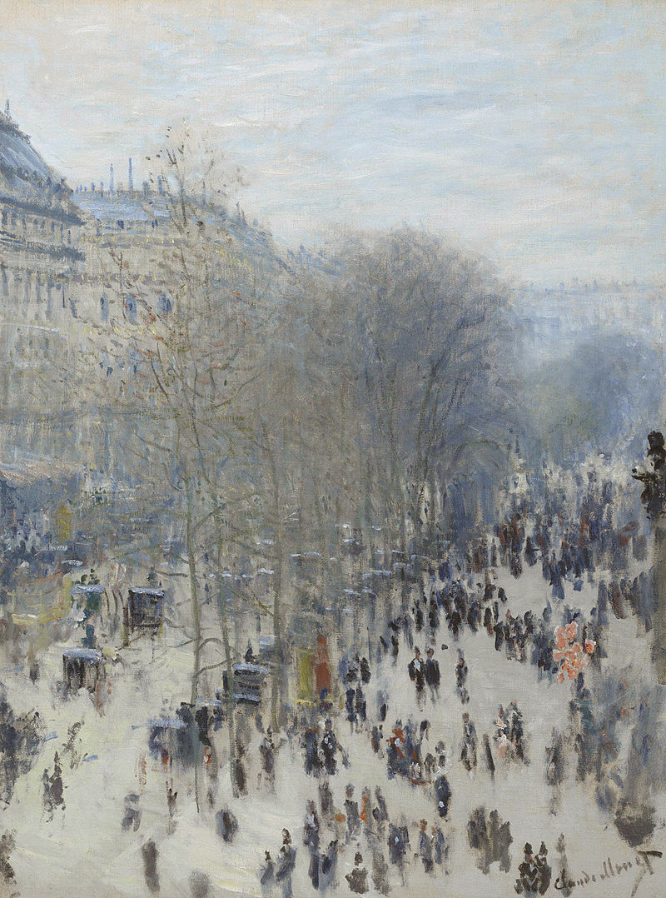
Claude Monet, Boulevard des Capucines.
1873-74.

Slide 15
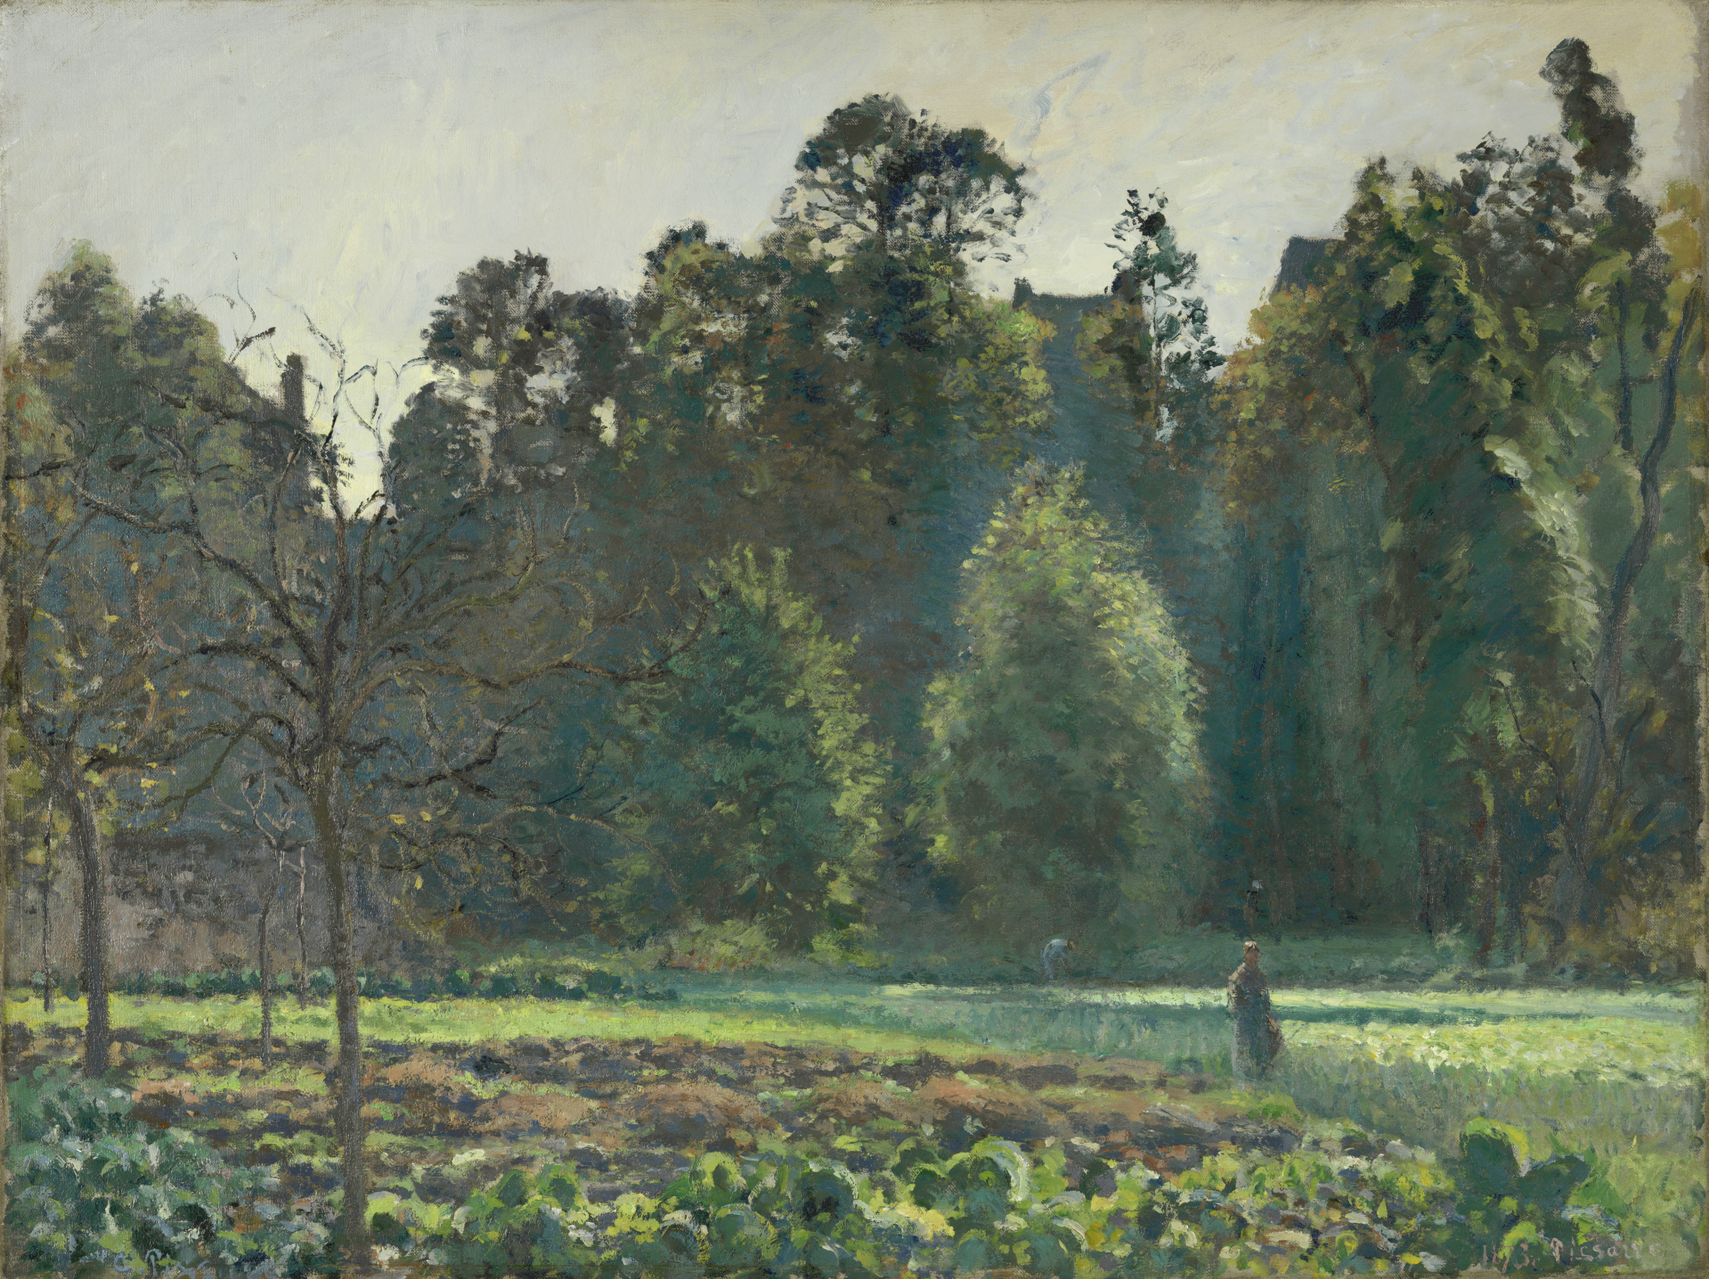
Camille Pissarro.
The Cabbage Field, Pontoise.
1873

Slide 16
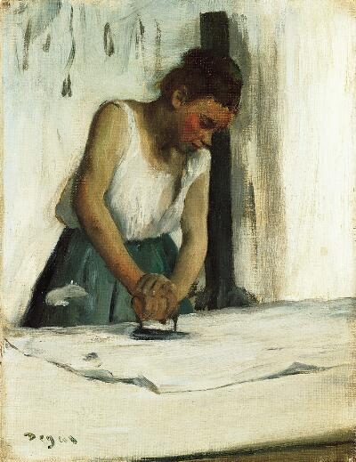
Edgar Degas.
The Laundress. 1873.
Yesterday I spent the whole day in the studio of a strange painter called Degas. He has fallen in love with modern life, and out of all the subjects in modern life he has chosen washerwomen and ballet dancers.
Edmond de Goncourt
The Laundress, so badly laundered.
Louis Leroy

Slide 17
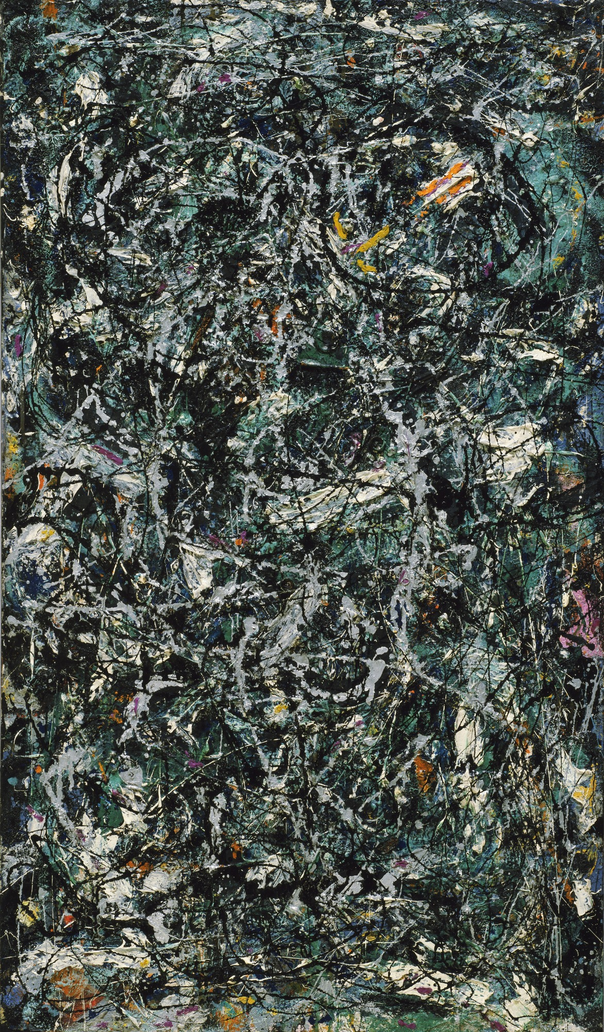
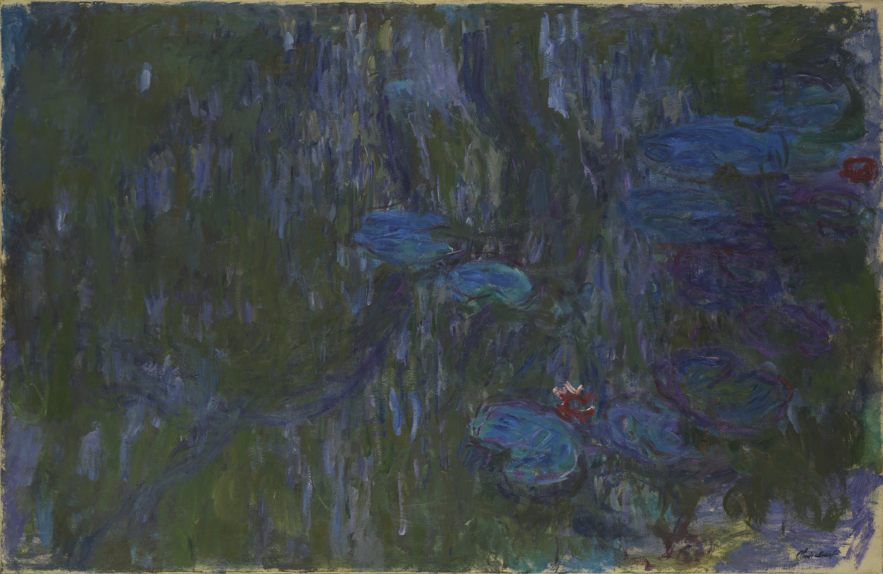

Slide 18
Claude Monet. Waterlilies. 1914-1926.
Jackson Pollock. Full Fathom Five. 1947.

Slide 19
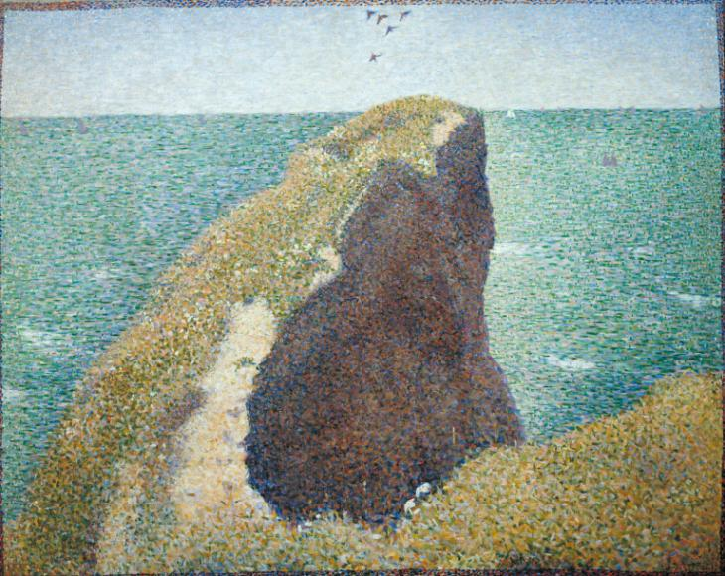
Neo Impressionism
Georges Seurat
Le Bec du Hoc, Grandcamp
1885

Slide 20
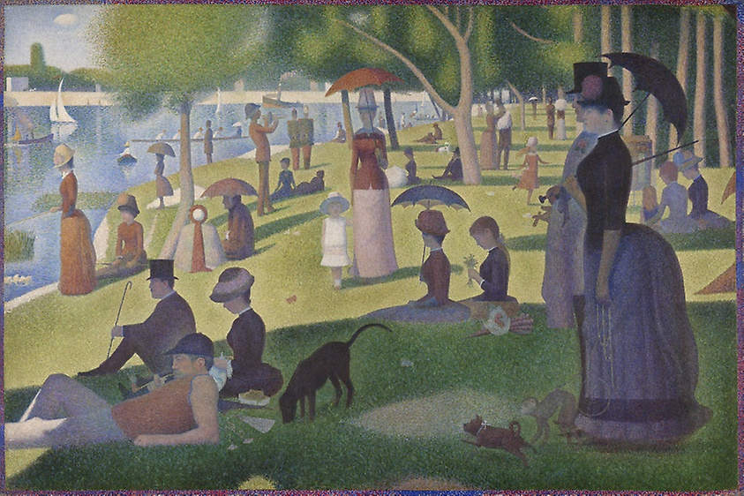
George Seurat. A Sunday on La Grande Jatte.
1884

Slide 21
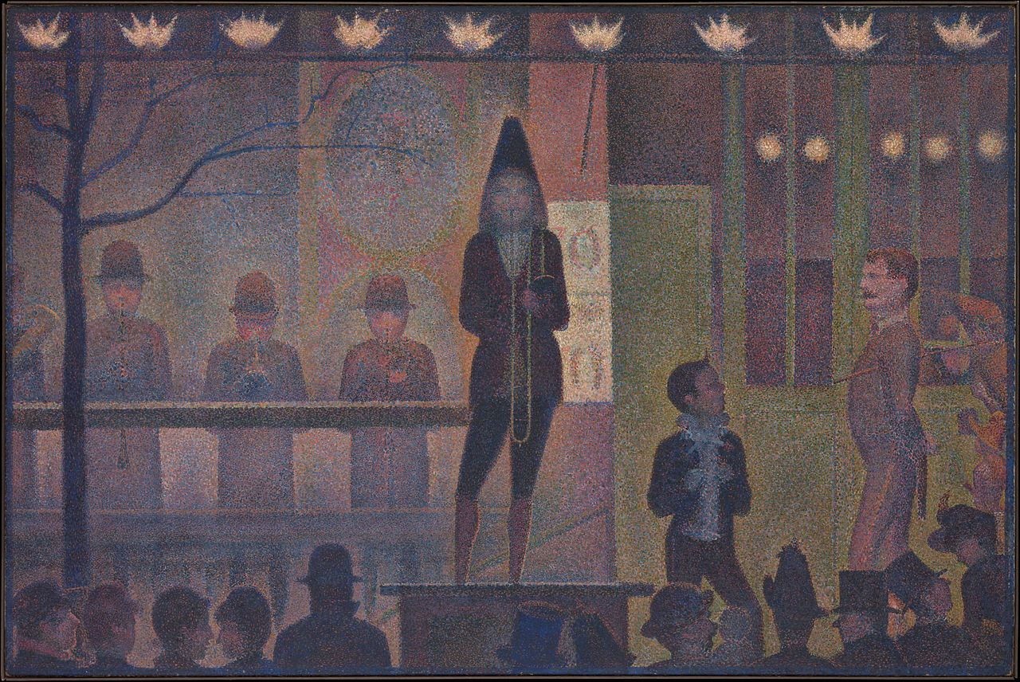
Georges Seurat. Parade de Cirque.
1887-8

Slide 22
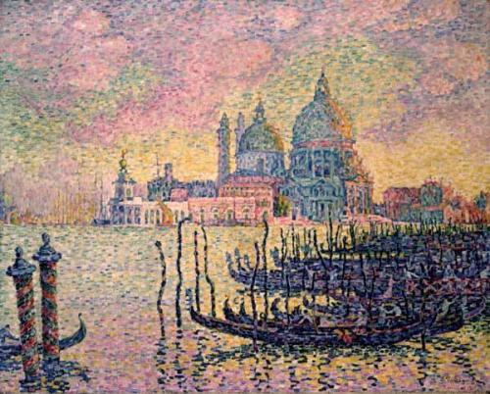
Paul Signac.
Entrance to the Grand Canal, Venice.
1905

Slide 23
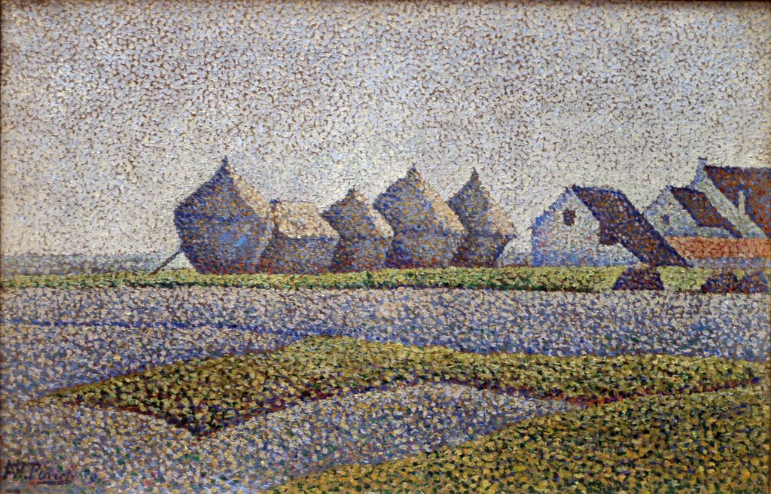
Alfred William Finch. Haystacks. 1889

Slide 24
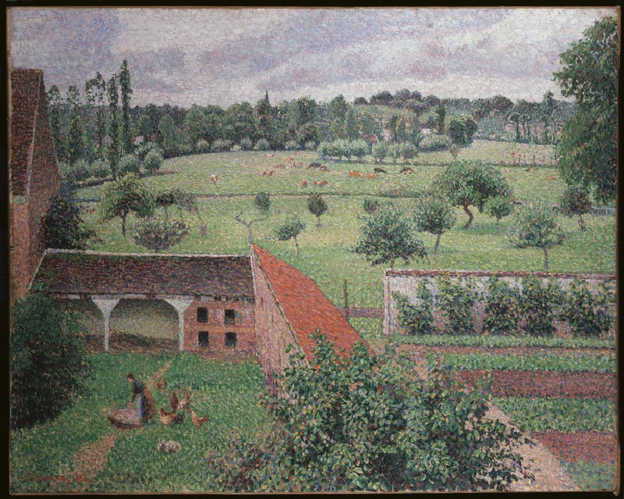
Camille Pissarro. View From my Bedroom Window.
1888

Slide 25
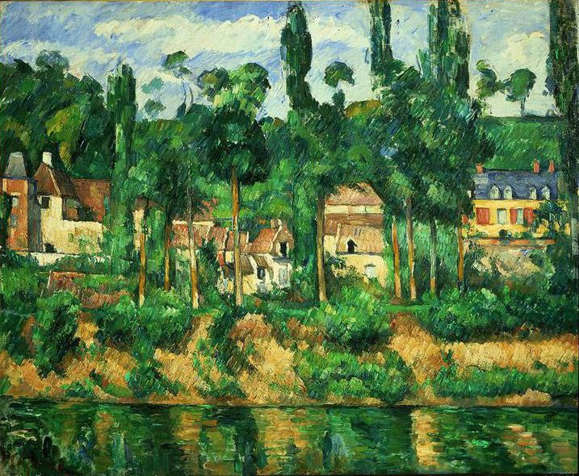
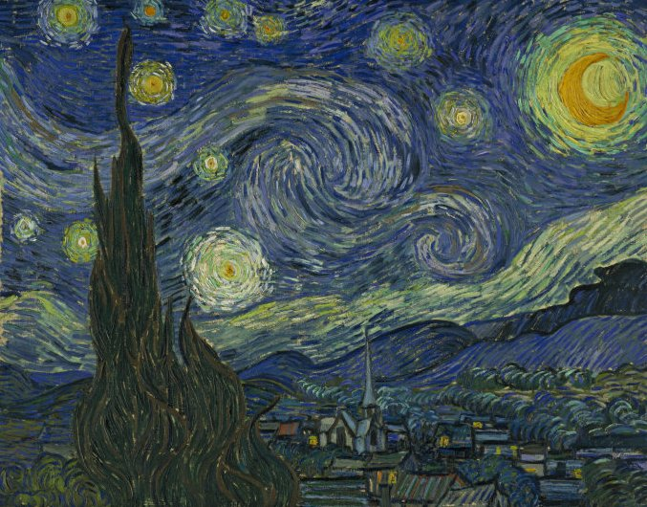
Post Impressionism
Paul Cezanne Zola's House at Medan. c1880
Vincent van Gogh. Starry Night. 1889

Slide 26
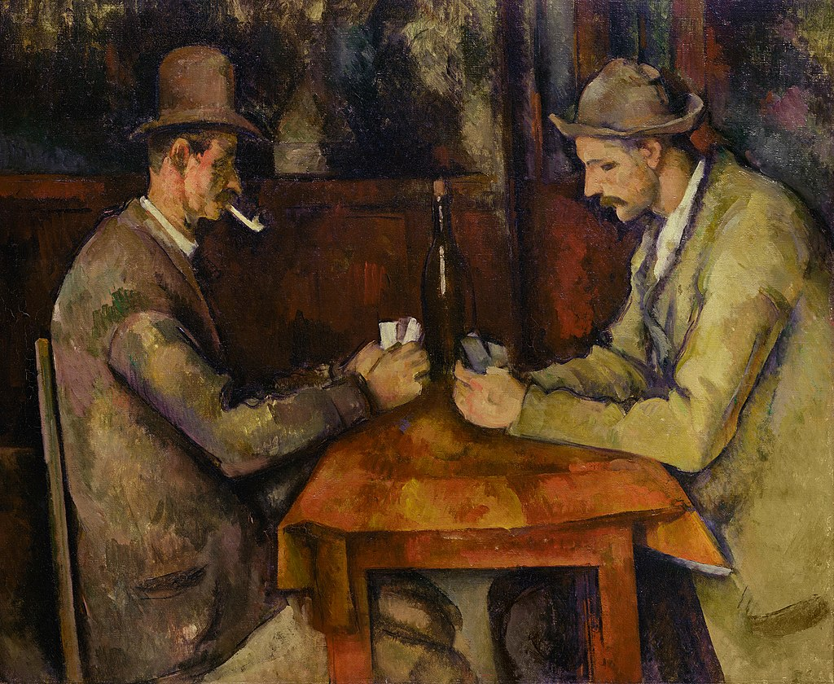
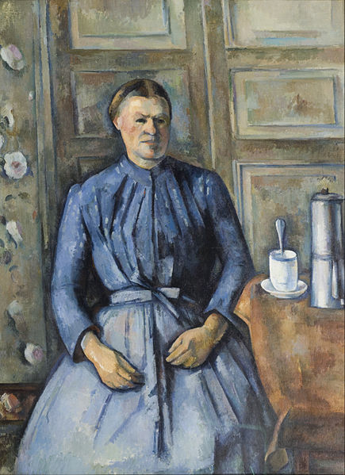
Paul Cézanne. Studies in line and form.
The Card Players. 1894-5
Woman with a coffee pot. 1895

Slide 27
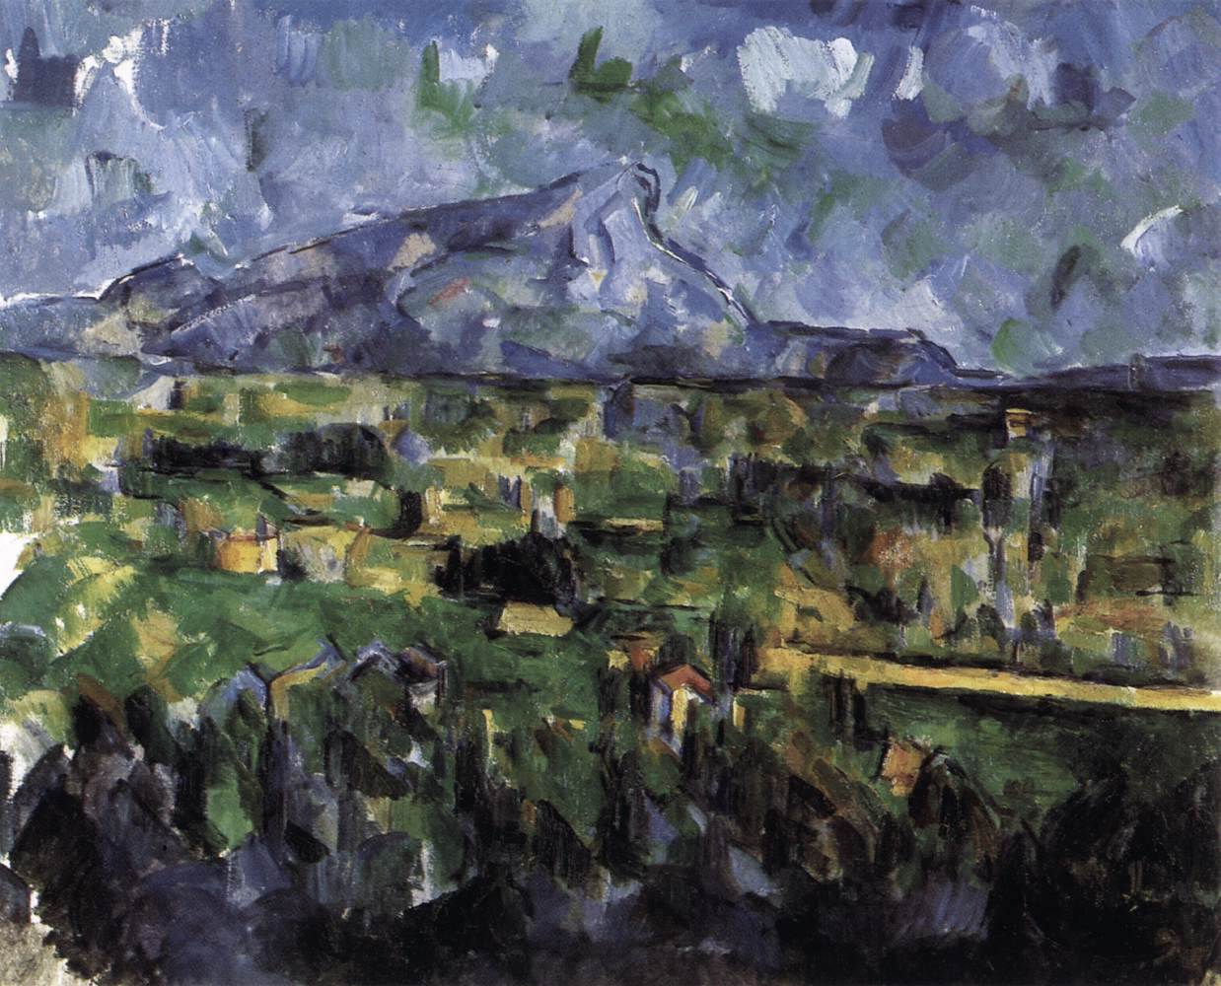
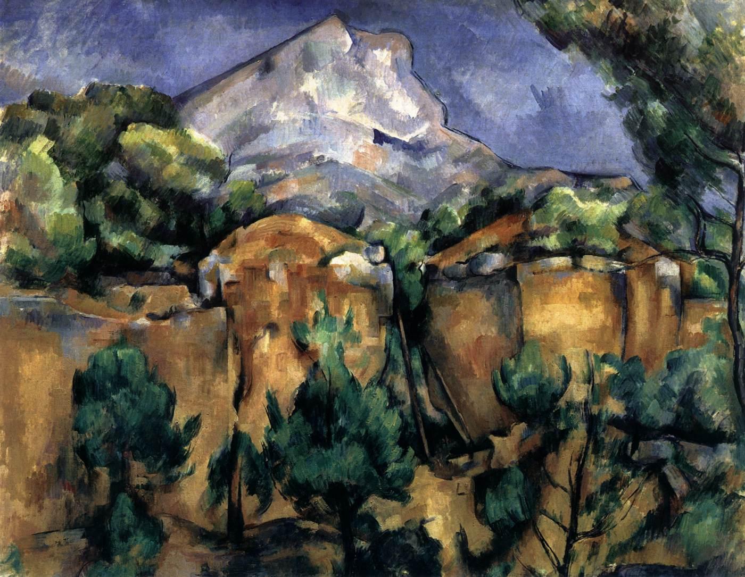
Paul Cézanne. Mont St. Victoire.
1897
1902-6

Slide 28

Vincent van Gogh.
Les Alpilles. 1890

Slide 29
Vincent Van Gogh. Wheatfield with Crows. 1890

Slide 30

Vincent van Gogh
The Sower. 1888

Slide 31


Post Impressionism. Cloisonnism.
Émile Bernard. Breton Women in the Meadow. 1888
Vincent van Gogh. La Salle de Danse. 1888

Slide 32


Post Impressionism. Synthetism
Paul Gauguin. Harvest: Le Pouldu. 1890
Emile Bernard. Harvest by the Sea. 1891

Slide 33


Primitivism
Gaudier Brzeska
Heiratic head of Ezra Pound
1914
Hoa Hakananai’a
Easter Island c1000AD

Slide 34


Giacometti
Tall Figure II 1948-49
L’Ombre du Soir. Etruscan
c350-300 BC

Slide 35


Cycladic head. 2700-2300 BC
Brancusi . The Muse. 1912

Slide 36


Fang Ngil Mask
Amadeo Modigliani.
Head of a woman. (Anna Zborowska). 1918

Slide 37


Gabon Mahongwe mask
Pablo Picasso Les Demoiselles d'Avignon 1907

Slide 38

CUBISM
"Braque has just sent in [to the 1908 Salon d'Automne] a painting made of little cubes”.
Henri Matisse.
George Braque. Houses at L'Estaque. 1908

Slide 39

Pablo Picasso. Factory, Horta de Ebro. 1909

Slide 40


Portrait of Ambroise Vollard. 1910
Picasso.
Analytical Cubism
Nude Woman. 1910

Slide 41




Jean Metzinger
Le goûter (Tea Time)
1911

Slide 42

Juan Gris Fantomas 1915

Slide 43


The breakdown of the image.
Pablo Picasso.
Portrait of Daniel Henry Kahnweiler. 1910
George Braque.
The Portuguese. 1911

Slide 44

Synthetic Cubism.
The building up of the image.
Pablo Picasso.
Still Life with Chair caning. 1912

Slide 45


Picasso. Constructed Sculpture
Guitar. 1912.
Mandolin and Clarinet. 1913

Slide 47
Constantin Brancusi
Bird in Space
1923-1940

Slide 48



De Stijl. Neo Plasticism and Elementarism

Slide 49

Piet Mondrian.
Windmill in Sunlight.
1908

Slide 50

Piet Mondrian.
Study for Grey Tree. 1911. - Grey Tree. 1911. - Flowering Apple Tree. 1912

Slide 51

Piet Mondrian. Ocean 5. 1914

Slide 52
M.H.J. Schoenmaekers
“The two fundamental complete contraries which shape our earth are: the horizontal line of power, that is the course of the earth around the sun and the vertical spatial movement of rays that originates in the centre of the sun”.
“The three principal colours are yellow, blue and red. They are the only colours existing”.

Slide 53


Piet Mondrian.
Composition in Colour A and Composition in Colour B. 1917
The colours of nature cannot be reproduced on canvas. Instinctively, I felt that painting had to find a new way to express the beauty of nature.

Slide 54


Bart van der Leck.
Geometric Composition. 1918
Theo van Doesburg. Russian Dancer. 1918.

Slide 55

Bart van der Leck. The Drinker. 1919.
Theo van Doesburg.
Contra-composition V. 1924.

Slide 56

Gerrit Rietveld. 3D de Stijl.
Red and Blue Chair. 1917
Rietveld-Schroder House, Utrecht. 1924

Slide 57


Piet Mondrian.
Composition No. III with Red, Yellow and Blue. 1935
Composition II in Red, Blue, and Yellow. 1930

Slide 58

Piet Mondrian. Broadway Boogie Woogie.
1942

Slide 59

SUPREMATISM
The free white sea,
infinity lies before you.

Slide 60


Kazimir Malevich. 1878-1935
Morning after the snowstorm. 1913
Woman with pails. 1912

Slide 61

Kazimir Malevich, Black Square, 1915

Slide 62



Slide 63


Kazimir Malevich. Suprematist dynamism.
Suprematist Composition (with eight red rectangles). 1915.
Suprematist Cross. 1920s

Slide 64

Kazimir Malevich
White on White.
1918
The climb to the top of non-figurative art is hard and full of torment…but satisfying nonetheless. Real things move further and further back, objects disappear with each step back, until at last the world of ordinary ideas, in which we live, vanishes altogether. Away with pictures of reality, away with ideal representation.

Slide 65

CONSTRUCTIVISM

Slide 66

El Lissitzky.
Beat the Whites with the Red Wedge.
1920

Slide 67

El Lisstzky.
Story of Two Squares.
1922

Slide 68

Aleksandr Rodchenko
Composition No. 47.
1917

Slide 69


Aleksandr Rodchenko
Lenin Workers Club in Paris. 1925
Advertising poster for
State Airline Dobrolet. 1923.

Slide 70


Constructivism: art or engineering?
El Lissitzky. Wolkenbügel (Cloud Hangar). 1924
Rodchenko.
Photograph of The Shukhov Tower. 1919
Proun. The new art object.

Slide 71

Vladimir Tatlin. Monument to the Third International. 1917-1920

Slide 72

Liubov Popova.
Space-force construction. 1921
“energetics” and “organisation”

Slide 73

Aleksandr Rodchenko.
Pure Red Colour, Pure Yellow Colour, Pure Blue Colour.
1921
I reduced painting to its logical conclusion and exhibited three canvases: red, blue and yellow. I affirmed: it’s over. Basic colours. Every plane is a plane and there is to be no representation.

Slide 74

RAYISM
Forms arising from the intersection of reflected rays of various objects.
Mikhail Larionov. Rayist Sausages and Mackerel. 1912

Slide 75


Makhail Larionov. 1881-1964
Red Rayism, 1913
Blue Rayism, 1912

Slide 76


Nataliya Goncharova 1881-1962
Cyclist. 1913
Cats: Rayist Perception in Rose, Black and Yellow. 1912

Slide 77

Natalya Goncharova
Dynamo Machine
1913

Slide 78


Nataliya Goncharova.
Rayism. Blue Green Forest. 1913
Mikhail Larionov. Nocturne. 1913-14

Slide 79

FUTURISM
Die in the past.
Live in the Future.
Umberto Boccioni.
Unique Forms of Continuity in Space. 1913

Slide 80


Ugo Giannattasio (1888-1958)
Motor Car. 1920

Slide 81

Umberto Boccioni. (1882-1916)
Riot in the Gallery. 1910
We wish to destroy museums, libraries, academies of any sort.
F.T.Marinetti. The Futurist Manifesto. 1909

Slide 82


Gino Severini. 1883-1966.
Le Nord-Sud. 1912
Suburban Train arriving in Paris. 1915

Slide 83

Umberto Boccioni.
The Forces of the Street.
1911.

Slide 84


Futurism: how to paint the moving object
Giacomo Balla, Dynamism of a Dog on a Leash. 1912
Eadweard Muybridge: The Horse in Motion. 1878

Slide 85

Umberto Boccioni
Dynamism of a Speeding Horse + Houses 1914-15

Slide 86

C.R.W.Nevinson
(1889-1946)
La Mitrailleuse. 1915
We wish to glorify war - the sole cleanser of the world.
F.T.Marinetti. The Futurist Manifesto. 1909

Slide 87


VORTICISM
This impure Present our Vortex despises and ignores.
For our Vortex is uncompromising.

Slide 88


Roger Fry
The Breakfast Table c1918
Landscape with Shepherd. 1891

Slide 89

Helen Saunders.
Monochrome Abstract Design. 1915.
Our Vortex rushes out like an angry dog at your Impressionistic fuss.

Slide 90

Edward Wadsworth.
Abstract Composition. 1915
“The vortex is the point of
maximum energy”. Ezra Pound
We should think “at once of a whirlpool. At the heart of the whirlpool is a great silent place where all the energy is concentrated”. Wyndham Lewis

Slide 91


Wyndham Lewis
Vorticist Construction.
1915
Workshop. 1914-15

Slide 92


David Bomberg. The Mudbath. 1914
Wyndham Lewis. The Crowd. 1915

Slide 93


Alvin Langdon Coburn. Vortography
Vortograph. 1917
Marius de Zayas. 1914

Slide 94


Jacob Epstein. Rock Drill.

Slide 95

SYMBOLISM
The mysterious centre
of thought.
Arnold Böcklin.
The Isle of the Dead. 1880

Slide 96


Early Symbolism. Religion, Mythology and Poetry
Dante Gabriel Rossetti. Beata Beatrix. 1864-70
Gustave Moreau. The_Apparition. 1876

Slide 97

Odilon Redon
The Eye Like a strange balloon mounts towards infinity.
1882

Slide 98

Odilon Redon
Woman with a vase of flowers.
1895-1905

Slide 99

Paul Gauguin.
Vision after the Sermon (Jacob Wrestling with the Angel)
1888.

Slide 100

Paul Gauguin. Faa Iheihe. 1898

Slide 101

Gustav Klimt. Beethoven Frieze. The longing for happiness finds repose in poetry. 1902

Slide 102

SURREALISM
as beautiful as the chance encounter of a sewing-machine and an umbrella on a dissecting table
Comte de Lautréamont
Salvador Dali. Metamorphosis of Narcissus. 1937

Slide 103

Giorgio De Chirico.
Mystery and Melancholy of a Street.
1914

Slide 104

Max Ernst.
Two children are threatened by a nightingale.
1924
An hallucinatory succession
of contradictory images.
Dramas which reveal my
most secret desires.

Slide 105

Jean Miro.
The Tilled Field.
1923-4

Slide 106

Max Ernst.
Pieta or Revolution by Night.
1923

Slide 107


André Masson: automatic drawing and the unconscious.

Slide 108

André Masson. Battle of Fishes. 1926

Slide 109


The Surrealist Object.
Meret Oppenheim. Le Déjeuner en fourrure. 1936
Salvador Dali. Lobster Telephone. 1936.

Slide 110


Salvador Dali and Mae West.
Face of Mae West which may be used as an apartment. 1936.
Mae West Lips as a Sofa. 1936

Slide 111

Leonora Carrington.
The Pomps of the Subsoil. 1947
The paintings of Leonora Carrington are not merely painted. They are brewed. They sometimes seem to have materialised in a cauldron at the stroke of midnight.
Edward James.

Slide 112
René Magritte. The Treachery of Images.
1928-9

Slide 113

André Derain (1880-1954)
Charing Cross Bridge. 1906
FAUVISM
Colours became charges of dynamite.
Everything could be raised above the real.

Slide 114

Henri Matisse. 1869-1954.
Woman with the Hat. 1905

Slide 115

Henri Matisse. Woman on a Terrace. 1906

Slide 116


Maurice de Vlaminck. 1876-1958
Houses at Chatou. 1905
The River Seine at Chatou. 1906

Slide 117

Henri Matisse
Luxe, Calme et Volupte. 1905

Slide 118

Henri Matisse.
Bonheur de Vivre.
1905-06

Slide 119


Slide 120

EXPRESSIONISM
Erich Heckel. Man on a Plain. 1917

Slide 121


The beginnings of Expressionism
James Ensor. The Skeleton Painter. 1896
Edvard Munch. Anxiety. 1894.

Slide 122


Die Brücke (The Bridge)
Karl Schmidt-Rottluff. Woman with a Bag. 1915
Ernst Kirchner. Street, Dresden. 1919

Slide 123

Karl Schmidt-Rottluff
Dangast Landscape. 1910

Slide 124


Emil Nolde. 1867-1956
Paradise Lost. 1921
Self Portrait. 1917

Slide 125

George Grosz
The Love Sick Man. 1916

Slide 126



Austrian Expressionism
Oskar Kokoschka.
Self Portrait of a Degenerate Artist. 1937
Richard Gerstl.
Self Portrait, Laughing. 1907
Egon Schiele
Self Portrait
1911

Slide 127

Wassily Kandinsky
(1866-1944)
The Blue Rider 1903
Der Blaue Reiter.
(The Blue Rider)

Slide 128

Alexei von Jawlensky Solitude
1912
The artist only utters what he has in himself, not what he sees with his eyes.

Slide 129

Franz Marc
(1880-1916).
Blue Horses. 1911

Slide 130

Wassily Kandinsky.
Landscape near Murnau with Locomotive
1909

Slide 131

Wassily Kandinsky Composition V 1911

Slide 132

Composition VII. 1913

Slide 133
Wassily Kandinsky
Upward
1929

Slide 134


Art Informel
Tachism
CoBrA
Painting is there to communicate and express our sublime state, our luminous explosion in space.
Gillian Ayres.
Hans Hartung. T1935-1
Gillian Ayres. Brood. 1962

Slide 135

Wols, (Alfred Otto Wolfgang Schulze)
It’s All Over The City.
1947

Slide 136


Hans Hartung
L73. 1958
24. 1953.

Slide 137

Georges Mathieu. Painting. 1952

Slide 138



Karel Appel Questioning Children 1949
C
o
B
r
A
Asger Jorn. Letter to my Son. 1956-7
Bram Bogart Threatened Cockerel
1956

Slide 139


Abstract Expressionism

Slide 140

Jackson Pollock
Mural
1943

Slide 141


Slide 142

Jackson Pollock. One: Number 31 1950

Slide 143

Lee Krasner
Composition. 1949
Gothic Landscape. 1961

Slide 144

Jackson Pollock. Blue Poles. 1952

Slide 145


Willem de Kooning
Woman I
1950
Woman V
1953

Slide 146

Barnett Newman
Onement 1
1948

Slide 147

Barnett Newman. Vir Heroicus Sublimis. 1950-51

Slide 148

Barnett Newman
Cathedra
1951

Slide 149



Clyfford Still
July 1945 R
Untitled D No-1
1957
Untitled – R- No. 1
1947

Slide 150



Mark Rothko
Red and Orange 1955
Untitled 1949
Untitled Brown and Grey. 1969

Slide 151


